Slide 1

Learning Python Programming
Dr.Sudhindra B.Deshpande
Associate Professor
KLS,Gogte Institute of Technology, Belagavi

Slide 2
Salient features:
Python is a high-level, interpreted, interactive and object-oriented scripting language.
Python is designed to be highly readable.
It uses English keywords frequently where as other languages use punctuation
It has fewer syntactical constructions than other languages.
Easy-to-learn: Python has few keywords, simple structure, and a clearly defined syntax. This allows the student to pick up the language quickly.
Easy-to-read: Python code is more clearly defined and visible to the eyes.
Easy-to-maintain: Python's source code is fairly easy-to-maintain.

Slide 3
Python is Interpreted and Interactive:
Python is processed at runtime by the interpreter.
You do not need to compile your program before executing it.
You can actually sit at a Python prompt and interact with the interpreter directly to write your programs.

Slide 4
Python is Object-Oriented:
Python supports Object-Oriented technique of programming and helps to achieve the following:
Security to data(data encapsulation)
Data and code reusability (inheritance /polymorphism)
Distributed software development (modular development)

Slide 5
Additional Features
A broad standard library: Python's bulk of the library is very portable and cross-platform compatible on UNIX, Windows, and Macintosh.
Interactive Mode: Python has support for an interactive mode which allows interactive testing and debugging of snippets of code.
Portable: Python can run on a wide variety of hardware platforms and has the same interface on all platforms.
Extendable: You can add low-level modules to the Python interpreter, these modules enable programmers to add to or customize their tools to be more efficient.

Slide 6
Additional Features
Databases: Python provides interfaces to all major commercial databases.
GUI Programming: Python supports GUI applications that can be created and ported to many system calls, libraries, and windows systems, such as Windows MFC, Macintosh, and the X Window system of Unix.
Scalable: Python provides a better structure and support for large programs than shell scripting.

Slide 7
Additional Features
It supports functional and structured programming methods as well as OOP.
It can be used as a scripting language or can be compiled to byte-code for building large applications.
It provides very high-level dynamic data types and supports dynamic type checking.
It supports automatic garbage collection.
It can be easily integrated with C, C++, COM, ActiveX, CORBA, and Java.

Slide 8
Modes of Programming
1. Interactive Mode Programming:
Invoking the interpreter without passing a script file as a parameter brings up the prompt
2.Script Mode Programming
Invoking the interpreter with a script parameter begins execution of the script and continues until the script is finished. When the script is finished, the interpreter is no longer active.

Slide 9
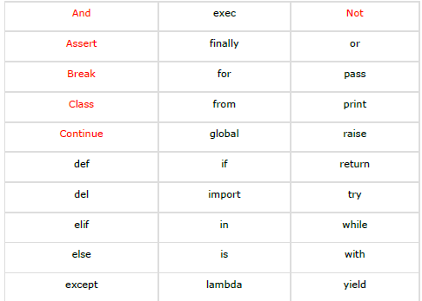
Keywords in Python

Slide 10
Lines and Indentation
No braces required to indicate blocks of code for class and function definitions or flow control.
Blocks of code are denoted by line indentation, which is rigidly enforced.
The number of spaces in the indentation is variable, but all statements within the block must be indented the same amount.

Slide 11
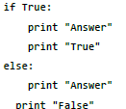

Correct
In Correct
all the continuous lines indented with same number of spaces would form a block.

Slide 12

Multi-Line Statements
allow the use of the line continuation character (\) to denote that the line should continue

Slide 13

Multi-Line Statements…
Statements contained within the [], {}, or () brackets do not need to use the line continuation character

Slide 14

Quotation in Python
Python accepts single ('), double (") and triple (''' or """) quotes to denote string literals, as long as the same type of quote starts and ends the string.
Triple quotes are used to span the string across multiple lines

Slide 15
Comments in Python
A hash sign (#) that is not inside a string literal begins a comment.
All characters after the # and up to the end of the physical line are part of the comment and the Python interpreter ignores them.

Slide 16
Waiting for the User
program displays the prompt, the statement saying , and waits for the user to take action:
input("\n\n Press ENTER key to exit.")

Slide 17
Multiple Statements on a Single Line
The semicolon ( ; ) allows multiple statements on the single line given that neither statement starts a new code block.

Slide 18
Variables in Python

Slide 19
Assigning Values to Variables
Python variables do not need explicit declaration to reserve memory space.
The declaration happens automatically when you assign a value to a variable.
The equal sign (=) is used to assign values to variables.
Example : num=100

Slide 20
Multiple Assignment
Python allows you to assign a single value to several variables simultaneously.
a = b = c = 1
an integer object is created with the value 1, and all three variables are assigned to the same memory location.

Slide 21
Multiple Assignment
can also assign multiple objects to multiple variables
a, b, c = 1, 2, "john“
Same as:
a = 1
b=2
c=“john”

Slide 22
Standard Data Types
Python has FIVE standard data types:
Numbers
String
List
Tuple
Dictionary

Slide 23
Python Numbers
Number data types store numeric values.
Number objects are created when you assign a value to them.
Examples:
A=10
B=20

Slide 24
Numeric data types in Python
Python supports four different numerical types:
int (signed integers)
long (long integers, they can also be represented in octal and hexadecimal)
float (floating point real values)
complex (complex numbers)

Slide 25
Deleting a variable
We can delete the reference to a number object by using the del statement.
del var1[,var2[,var3[....,varN]]]]
Examples:
del var
del var_a, var_b

Slide 26
Python Operators

Slide 27
Types of Operators
Arithmetic Operators
Comparison (Relational) Operators
Assignment Operators
Logical Operators
Bitwise Operators
Membership Operators
Identity Operators

Slide 28
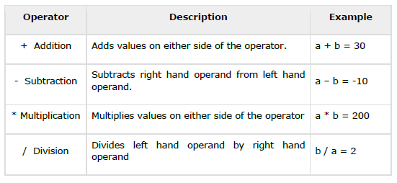
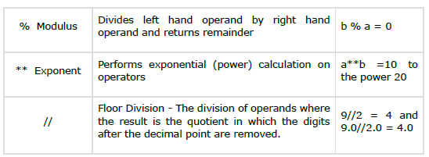
Python Arithmetic Operators

Slide 29
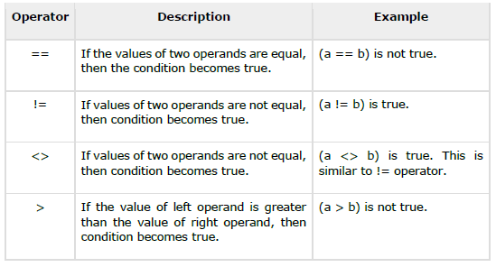
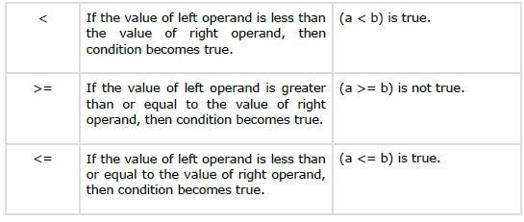
Python Comparison Operators / Relational operators

Slide 30
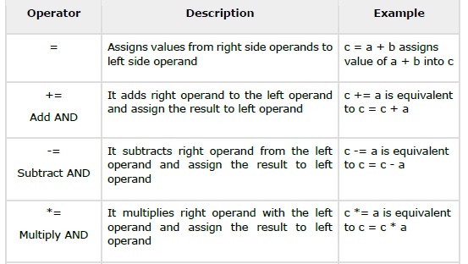
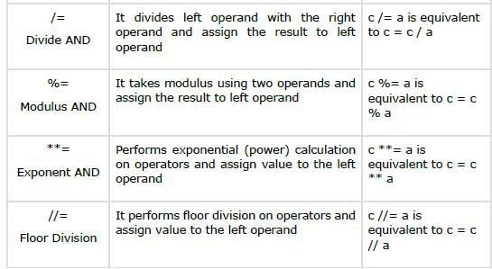
Python Assignment Operators

Slide 31
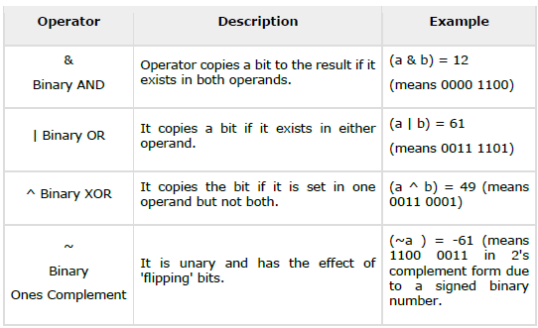
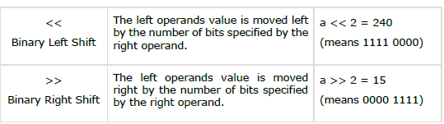
Python Bitwise Operators

Slide 32
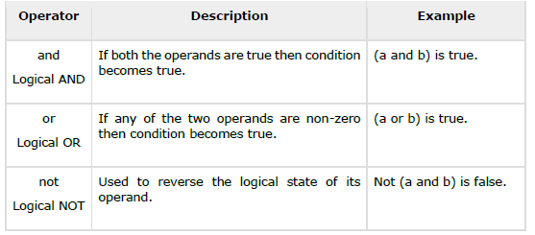
Python Logical Operators

Slide 33
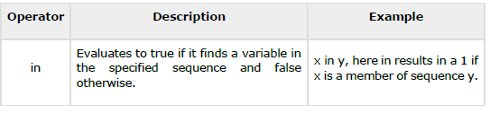

Python Membership Operators
membership operators test for membership in a sequence, such as strings, lists, or tuples

Slide 34
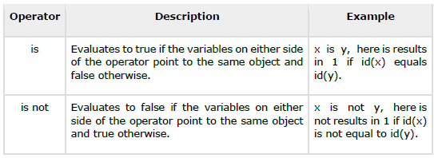
Python Identity Operators
Identity operators compare the memory locations of two objects

Slide 35
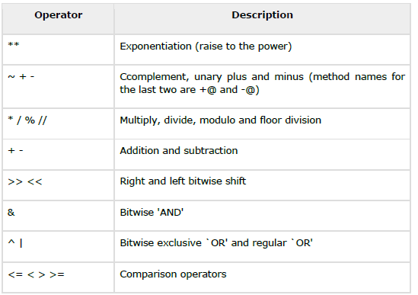
The following table lists all operators from highest precedence to lowest.

